Slide 1

Adjusting the
Accounts
Accounting Principles, Ninth Edition

Slide 2

Timing Issues
Accountants divide the economic life of a business into artificial time periods (Time Period Assumption).
. . . . .
Jan.
Feb.
Mar.
Apr.
Dec.
Generally a month, a quarter, or a year.
Fiscal year vs. calendar year
Also known as the “Periodicity Assumption”
SO 1 Explain the time period assumption.

Slide 3
Timing Issues
Accrual- vs. Cash-Basis Accounting
Accrual-Basis Accounting
Transactions recorded in the periods in which the events occur
Revenues are recognized when earned, rather than when cash is received.
Expenses are recognized when incurred, rather than when paid.
SO 2 Explain the accrual basis of accounting.

Slide 4
Timing Issues
Accrual- vs. Cash-Basis Accounting
Cash-Basis Accounting
Revenues are recognized when cash is received.
Expenses are recognized when cash is paid.
Cash-basis accounting is not in accordance with generally accepted accounting principles (GAAP).
SO 2 Explain the accrual basis of accounting.

Slide 5
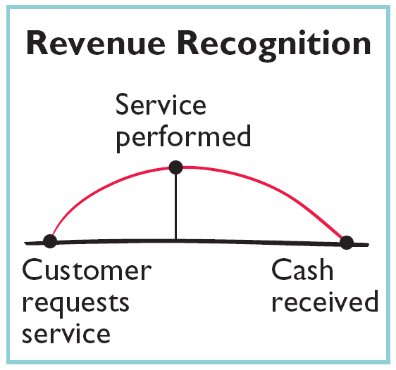
Timing Issues
Recognizing Revenues and Expenses
Revenue Recognition Principle
Companies recognize revenue in the accounting period in which it is earned.
In a service enterprise, revenue is considered to be earned at the time the service is performed.
SO 2 Explain the accrual basis of accounting.

Slide 6
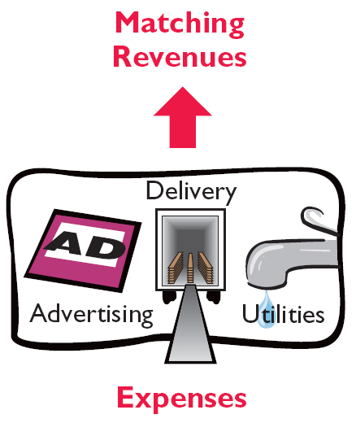
Timing Issues
Recognizing Revenues and Expenses
Matching Principle
Match expenses with revenues in the period when the company makes efforts to generate those revenues.
“Let the expenses follow the revenues.”
SO 2 Explain the accrual basis of accounting.

Slide 7
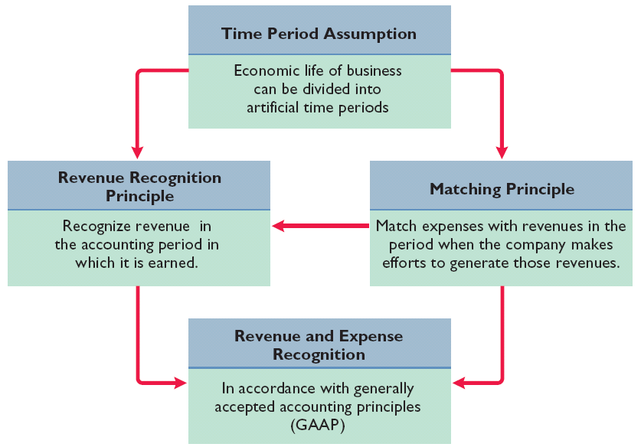
Timing Issues
GAAP relationships in revenue and expense recognition
Illustration 3-1
SO 2 Explain the accrual basis of accounting.

Slide 8
The Basics of Adjusting Entries
Adjusting entries make it possible to report correct amounts on the balance sheet and on the income statement.
A company must make adjusting entries every time it prepares financial statements.
SO 3 Explain the reasons for adjusting entries.

Slide 9
The Basics of Adjusting Entries
Revenues - recorded in the period in which they are earned.
Expenses - recognized in the period in which they are incurred.
Adjusting entries - needed to ensure that the revenue recognition and matching principles are followed.
SO 3 Explain the reasons for adjusting entries.

Slide 10
Types of Adjusting Entries
Illustration 4-2
Categories of adjusting entries
Deferrals
Accruals
1. Prepaid Expenses. Expenses paid in cash and recorded as assets before they are used or consumed.
3. Accrued Revenues. Revenues earned but not yet received in cash or recorded.
2. Unearned Revenues. Revenues received in cash and recorded as liabilities before they are earned.
4. Accrued Expenses. Expenses incurred but not yet paid in cash or recorded.
SO 4 Identify the major types of adjusting entries.

Slide 11
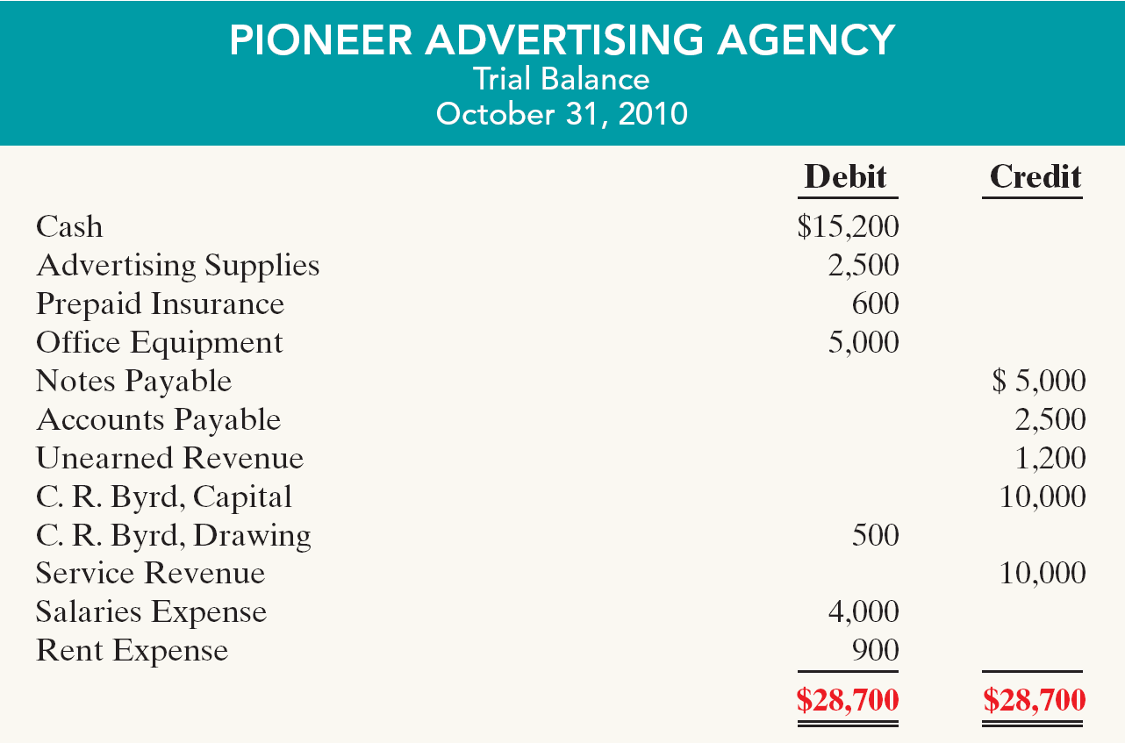
Trial Balance
Trial Balance – Each account is analyzed to determine whether it is complete and up-to-date.
Illustration 3-3
SO 4 Identify the major types of adjusting entries.

Slide 12
Adjusting Entries for Deferrals
Deferrals are either:
Prepaid expenses
OR
Unearned revenues.
SO 5 Prepare adjusting entries for deferrals.

Slide 13
Adjusting Entries for “Prepaid Expenses”
Payment of cash that is recorded as an asset because service or benefit will be received in the future.
Cash Payment
BEFORE
Expense Recorded
Prepayments often occur in regard to:
  insurance
  supplies
  advertising
  rent
  maintenance on equipment
  fixed assets (depreciation)
SO 5 Prepare adjusting entries for deferrals.

Slide 14
Adjusting Entries for “Prepaid Expenses”
Prepaid Expenses
Costs that expire either with the passage of time or through use.
Adjusting entries (1) to record the expenses that apply to the current accounting period, and (2) to show the unexpired costs in the asset accounts.
SO 5 Prepare adjusting entries for deferrals.

Slide 15
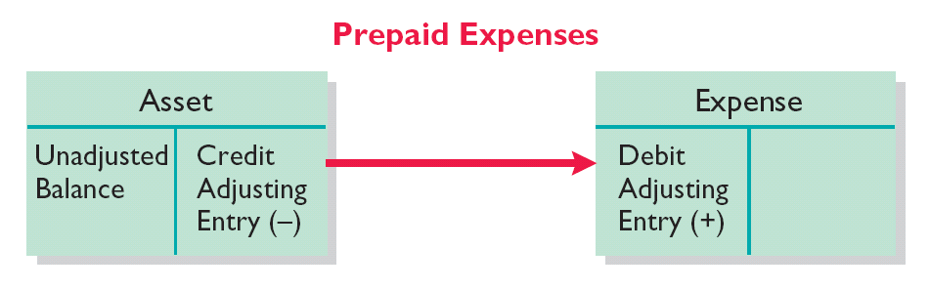
Adjusting Entries for “Prepaid Expenses”
Adjusting entries for prepaid expenses
Illustration 3-4
Increases (debits) an expense account and
Decreases (credits) an asset account.
SO 5 Prepare adjusting entries for deferrals.

Slide 16
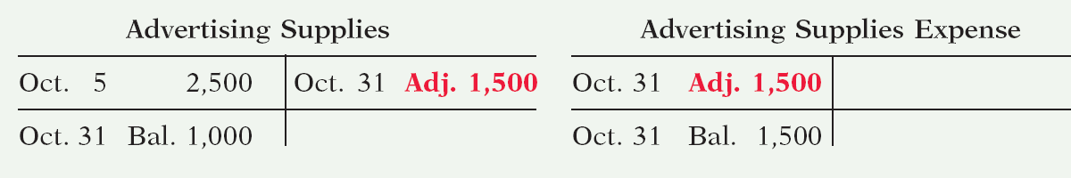
Adjusting Entries for “Prepaid Expenses”
Illustration: Pioneer Advertising Agency purchased advertising supplies costing $2,500 on October 5. Sierra recorded the payment by increasing (debiting) the asset Advertising Supplies. This account shows a balance of $2,500 in the October 31 trial balance. An inventory count at the close of business on October 31 reveals that $1,000 of supplies are still on hand.
Oct. 31
Advertising supplies expense
1,500
Advertising supplies
1,500
Illustration 3-5
SO 5 Prepare adjusting entries for deferrals.

Slide 17
Adjusting Entries for “Prepaid Expenses”
Illustration: On October 4, Pioneer Advertising Agency paid $600 for a one-year fire insurance policy. Coverage began on October 1. Pioneer recorded the payment by increasing (debiting) Prepaid Insurance. This account shows a balance of $600 in the
October 31 trial balance. Insurance of $50 ($600 / 12) expires each month.
Oct. 31
Insurance expense
50
Prepaid insurance
50
Illustration 3-6
SO 5 Prepare adjusting entries for deferrals.

Slide 18
Adjusting Entries for “Prepaid Expenses”
Depreciation
Buildings, equipment, and vehicles (long-lived assets) are recorded as assets, rather than an expense, in the year acquired.
Companies report a portion of the cost of a long-lived asset as an expense (depreciation) during each period of the asset’s useful life (Matching Principle).
SO 5 Prepare adjusting entries for deferrals.

Slide 19
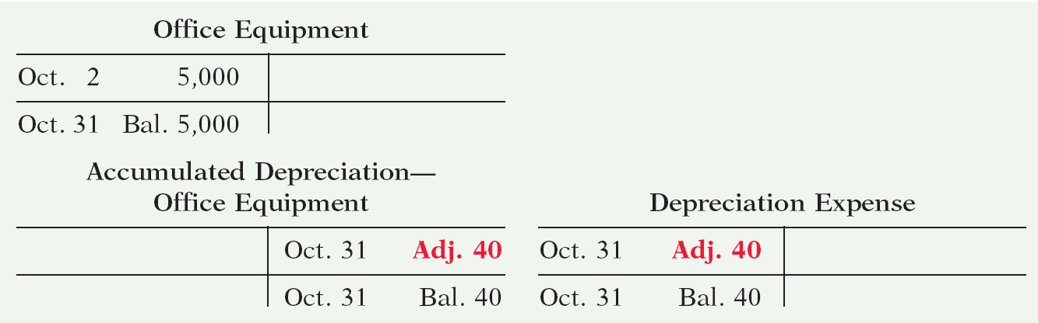
Adjusting Entries for “Prepaid Expenses”
Illustration: Pioneer Advertising estimates depreciation on the office equipment to be $480 a year, or $40 per month.
Oct. 31
Depreciation expense
40
Accumulated depreciation
40
Illustration 3-7
SO 5 Prepare adjusting entries for deferrals.

Slide 20
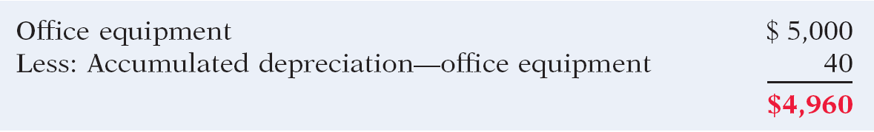
Adjusting Entries for “Prepaid Expenses”
Depreciation (Statement Presentation)
Accumulated Depreciation is a contra asset account.
Appears just after the account it offsets (Equipment) on the balance sheet.
Illustration 3-8
SO 5 Prepare adjusting entries for deferrals.

Slide 21
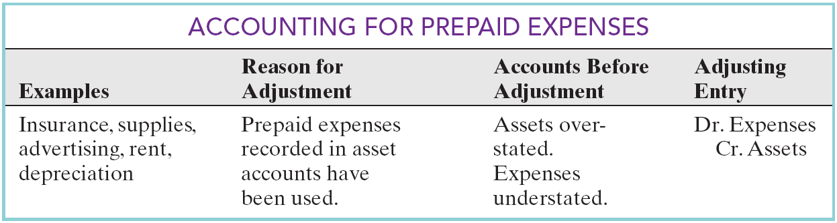
Adjusting Entries for “Prepaid Expenses”
Summary
Illustration 3-9
SO 5 Prepare adjusting entries for deferrals.

Slide 22
Adjusting Entries for “Unearned Revenues”
Receipt of cash that is recorded as a liability because the revenue has not been earned.
Cash Receipt
BEFORE
Revenue Recorded
Unearned revenues often occur in regard to:
  rent
  airline tickets
  school tuition
  magazine subscriptions
  customer deposits
SO 5 Prepare adjusting entries for deferrals.

Slide 23
Adjusting Entries for “Unearned Revenues”
Unearned Revenues
Company makes an adjusting entry to record the revenue that has been earned and to show the liability that remains.
The adjusting entry for unearned revenues results in a decrease (a debit) to a liability account and an increase (a credit) to a revenue account.
SO 5 Prepare adjusting entries for deferrals.

Slide 24
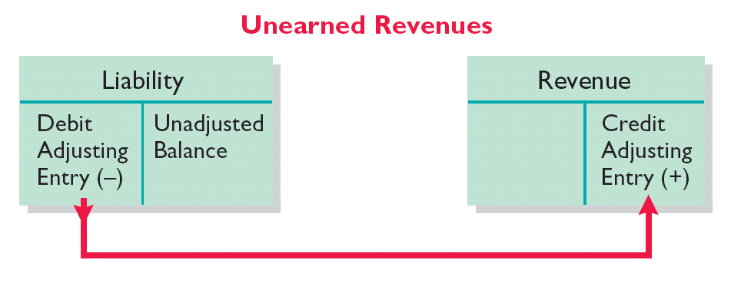
Adjusting Entries for “Unearned Revenues”
Adjusting entries for unearned revenues
Illustration 3-10
Decrease (a debit) to a liability account and
Increase (a credit) to a revenue account.
SO 5 Prepare adjusting entries for deferrals.

Slide 25
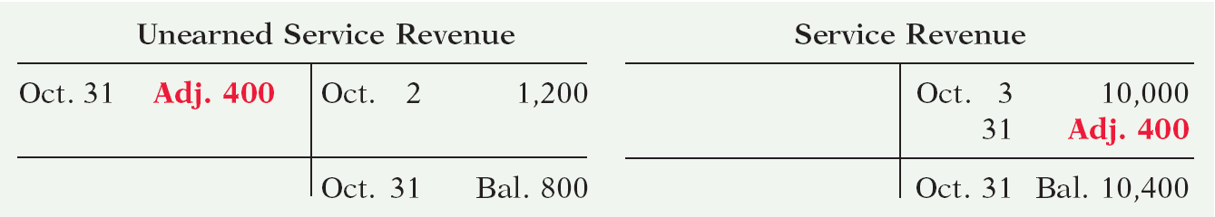
Adjusting Entries for “Unearned Revenues”
Illustration: Pioneer Advertising Agency received $1,200 on October 2 from R. Knox for advertising services expected to be completed by December 31. Unearned Service Revenue shows a balance of $1,200 in the October 31 trial balance. Analysis reveals that the company earned $400 of those fees in October.
Oct. 31
Unearned service revenue
400
Service revenue
400
Illustration 3-11
SO 5 Prepare adjusting entries for deferrals.

Slide 26
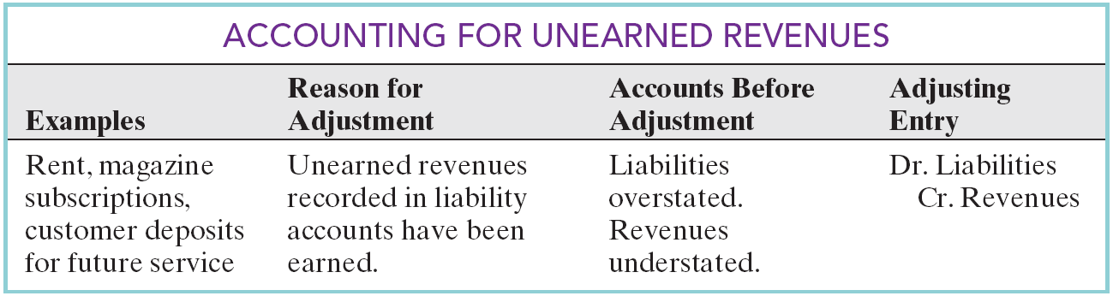
Adjusting Entries for “Unearned Revenues”
Summary
Illustration 3-12
SO 5 Prepare adjusting entries for deferrals.

Slide 27
Adjusting Entries for Accruals
Made to record:
  Revenues earned and
  OR
  Expenses incurred
in the current accounting period that have not been recognized through daily entries.
SO 6 Prepare adjusting entries for accruals.

Slide 28
Adjusting Entries for “Accrued Revenues”
Revenues earned but not yet received in cash or recorded.
Adjusting entry results in:
Revenue Recorded
BEFORE
Cash Receipt
Accrued revenues often occur in regard to:
  rent
  interest
  services performed
SO 6 Prepare adjusting entries for accruals.

Slide 29
Adjusting Entries for “Accrued Revenues”
Accrued Revenues
An adjusting entry serves two purposes:
(1) It shows the receivable that exists, and
(2) It records the revenues earned.
SO 6 Prepare adjusting entries for accruals.

Slide 30
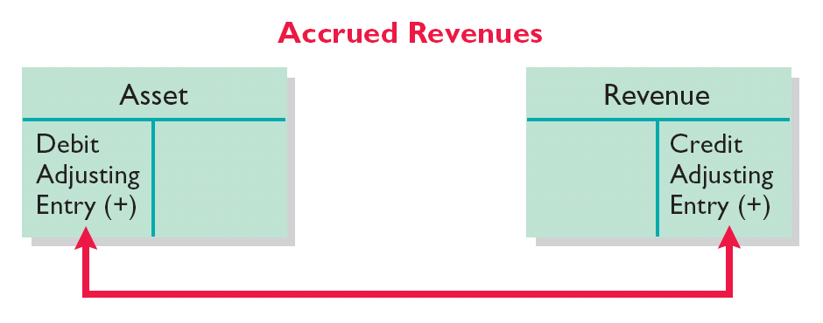
Adjusting Entries for “Accrued Revenues”
Adjusting entries for accrued revenues
Illustration 3-13
Increases (debits) an asset account and
Increases (credits) a revenue account.
SO 6 Prepare adjusting entries for accruals.

Slide 31
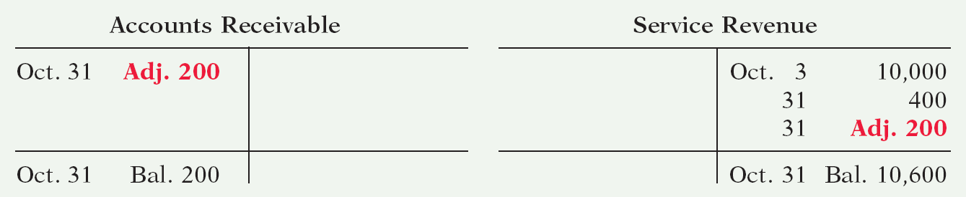
Adjusting Entries for “Accrued Revenues”
Illustration: In October Pioneer Advertising Agency earned $200 for advertising services that had not been recorded.
Oct. 31
Accounts Receivable
200
Service Revenue
200
Illustration 3-14
SO 6 Prepare adjusting entries for accruals.

Slide 32
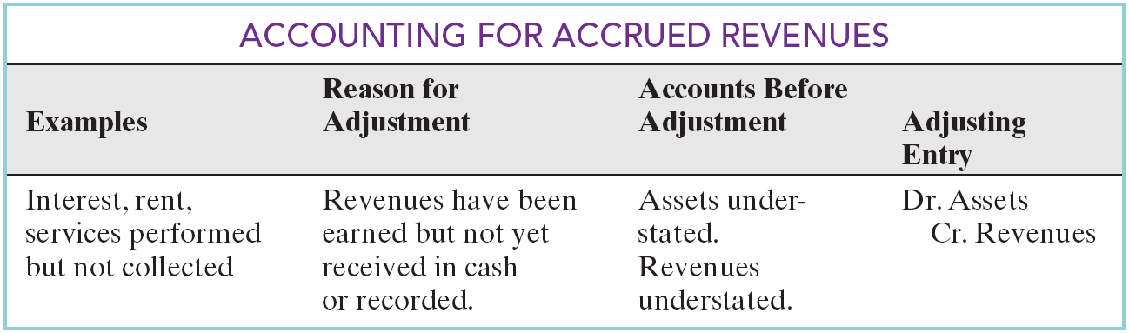
Adjusting Entries for “Accrued Revenues”
Summary
Illustration 3-15
SO 6 Prepare adjusting entries for accruals.

Slide 33
Adjusting Entries for “Accrued Expenses”
Expenses incurred but not yet paid in cash or recorded.
Adjusting entry results in:
Expense Recorded
BEFORE
Cash Payment
Accrued expenses often occur in regard to:
  rent
  interest
  taxes
  salaries
SO 6 Prepare adjusting entries for accruals.

Slide 34
Adjusting Entries for “Accrued Expenses”
Accrued Expenses
An adjusting entry serves two purposes:
(1) It records the obligations, and
(2) It recognizes the expenses.
SO 6 Prepare adjusting entries for accruals.

Slide 35
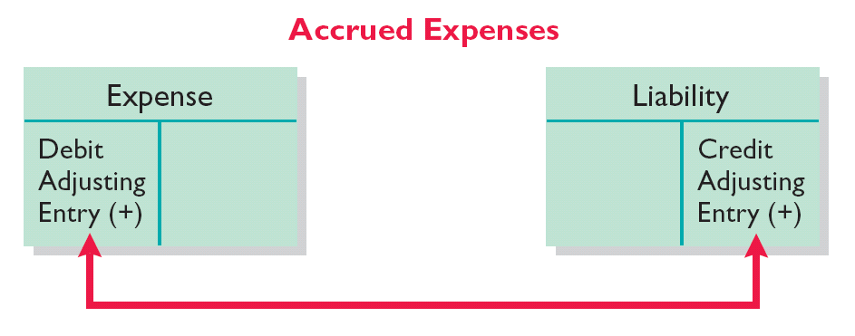
Adjusting Entries for “Accrued Expenses”
Adjusting entries for accrued expenses
Illustration 3-16
Increases (debits) an expense account and
Increases (credits) a liability account.
SO 6 Prepare adjusting entries for accruals.

Slide 36

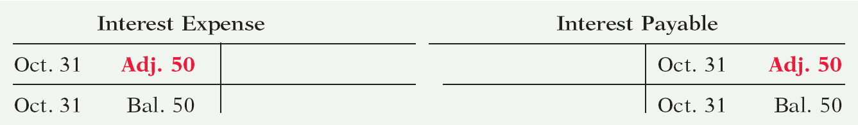
Adjusting Entries for “Accrued Expenses”
Illustration: Pioneer Advertising Agency signed a three-month note payable in the amount of $5,000 on October 1. The note requires Pioneer to pay interest at an annual rate of 12%.
Illustration 3-17
Oct. 31
Interest expense
50
Interest payable
50
Illustration 3-18
SO 6 Prepare adjusting entries for accruals.

Slide 37
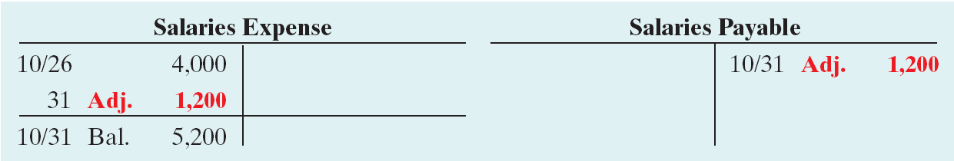
Adjusting Entries for “Accrued Expenses”
Illustration: Pioneer Advertising Agency last paid salaries on October 26; the next payment of salaries will not occur until November 9. The employees receive total salaries of $2,000 for a five-day work week, or $400 per day. Thus, accrued salaries at October 31 are $1,200 ($400 x 3 days).
Oct. 31
Salaries expense
1,200
Salaries payable
1,200
Illustration 3-20
SO 6 Prepare adjusting entries for accruals.

Slide 38
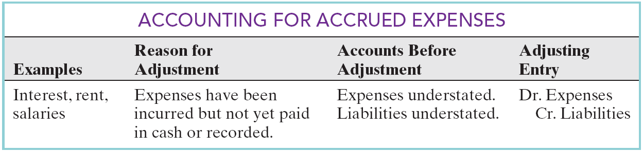
Adjusting Entries for “Accrued Expenses”
Summary
Illustration 3-21
SO 6 Prepare adjusting entries for accruals.

Slide 39
The Adjusted Trial Balance
After all adjusting entries are journalized and posted the company prepares another trial balance from the ledger accounts (Adjusted Trial Balance).
Its purpose is to prove the equality of debit balances and credit balances in the ledger.
SO 7 Describe the nature and purpose of an adjusted trial balance.

Slide 40
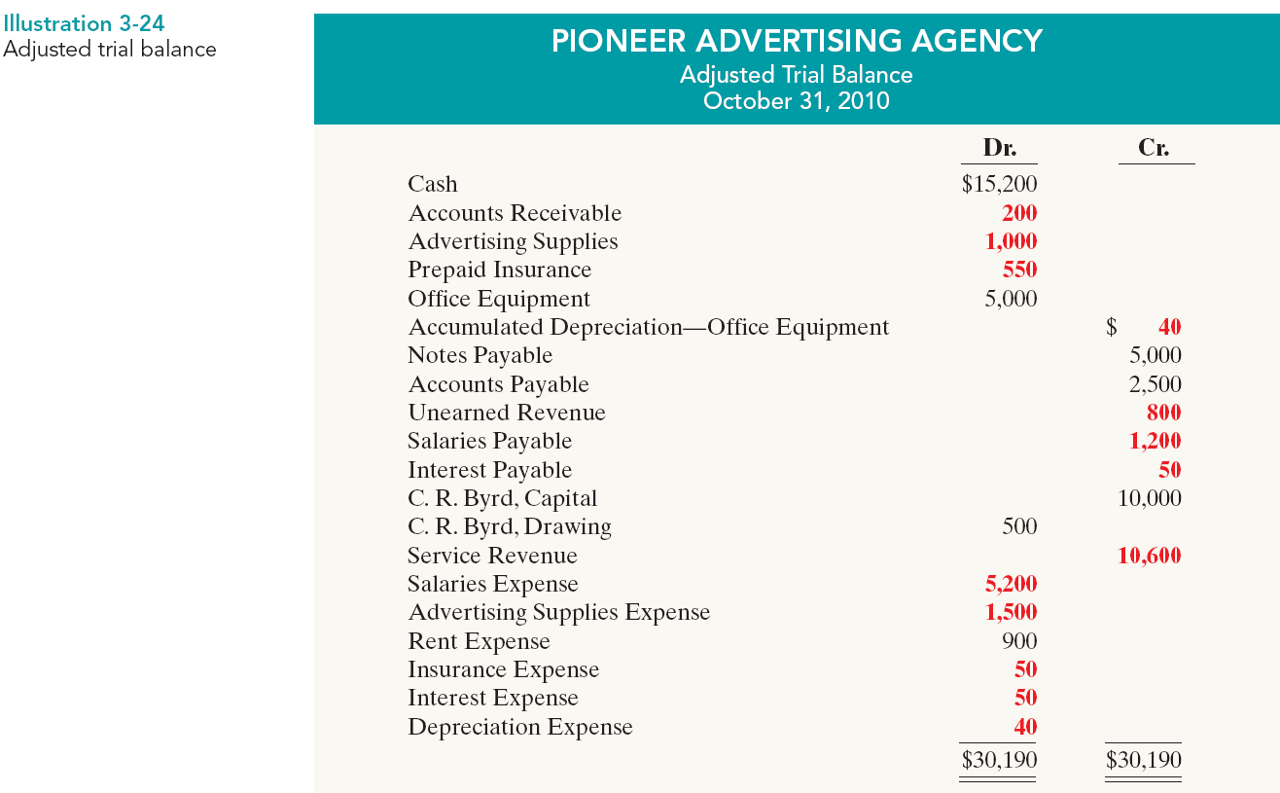
The Adjusted Trial Balance

Slide 41
Preparing Financial Statements
Financial Statements are prepared directly from the Adjusted Trial Balance.
Balance Sheet
Income Statement
Owner’s Equity Statement
SO 7 Describe the nature and purpose of an adjusted trial balance.

Slide 42
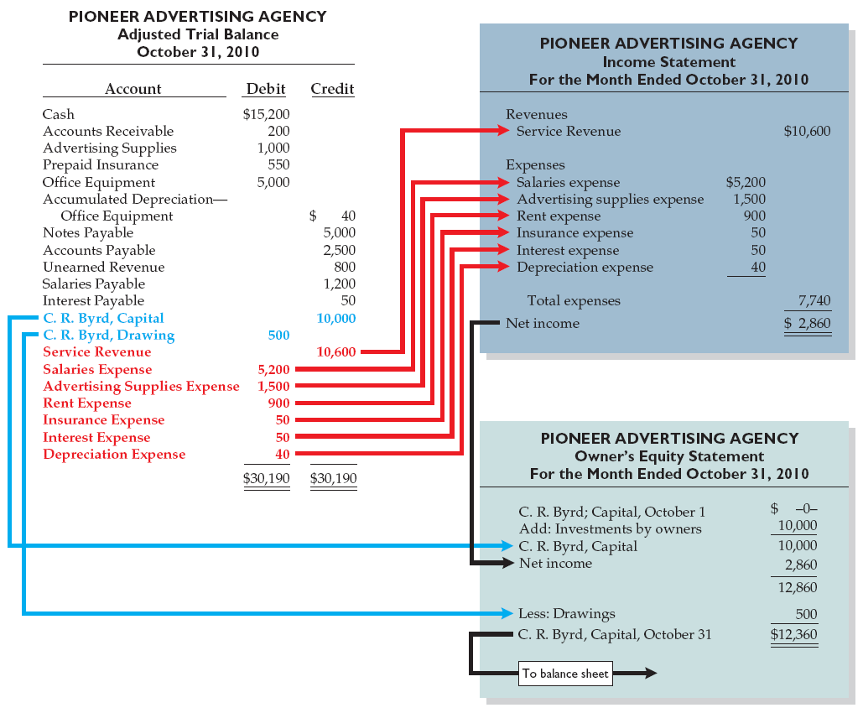
Preparing Financial Statements
Illustration 3-25 Preparation of the income
statement and owner’s
equity statement from the
adjusted trial balance

